Slide 1

university connector TEAM-GRADIENT
Student
Md Shahinur
Shadman Sakib Faruki
Ahammed Ekrak Hossain Utsha

Slide 2
Table Contents
Introduction
Key Features
User-Friendly Dashboard
Real-Time Messaging
Contact Management
Research management & collaboration
Learning path generator
Notification System
Security & Accessibility
Ai powered chatbot
Q&A with pdf
Video summarizer
Flashcard & Quiz Maker
Conclusion

Slide 3
Introduction
What is U-Connect?
UConnect is a university-exclusive social media platform, empowering students to share knowledge, collaborate on research, and connect with like-minded peers. For whom?
For students who are trying to make their future, lokking for peers, reseach collaboration and wants to do better using AI powered tools.
Why U-Connect?
🧠 Knowledge Sharing: Share posts, ideas, and academic resources easily
🏫 University-specific Communities: Connect within your university and department
👥 Field-based Collaboration: Join and explore communities in your field of interest
💬 Interactive Communication: Chat, comment, and engage with fellow students
📚 Research Paper Sharing: Showcase and discover research work among peers
📈 Professional Growth: Build your academic profile for future opportunities 🧠 AI powered tools: Q&A with pdf, video summarizer, learning path generator,flash card generator etc.

Slide 4
Key Features
Real-time messaging
Contact management
File sharing
Calendar and task tools
Notifications & mobile accessibility
Secure and user-friendly

Slide 5
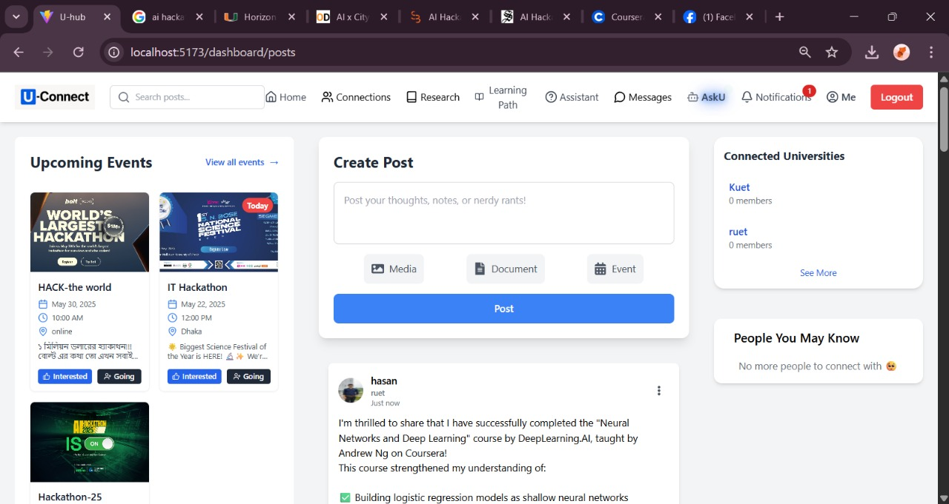
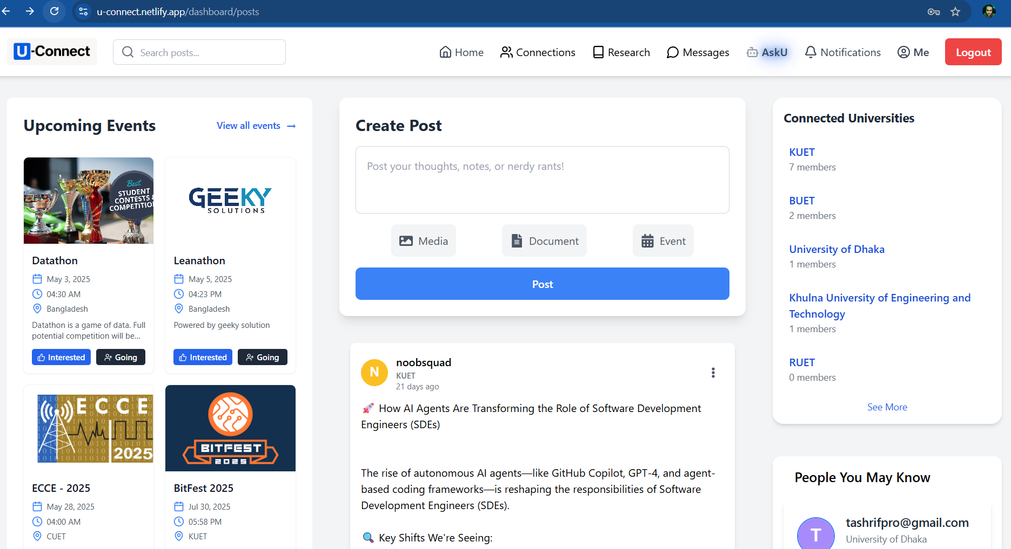
User-Friendly Dashboard
User avatars and message previews
Minimalist, intuitive interface
Quick access to essential tools
Upcoming Events
Creating post with image & documents

Slide 6
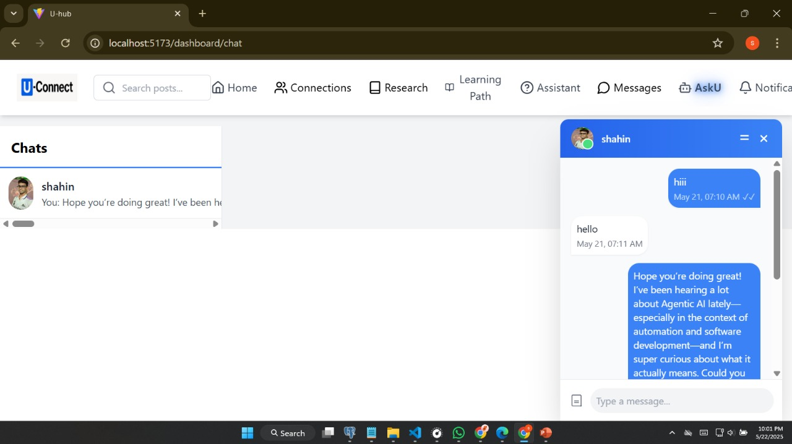
Real-Time Messaging
Peer to peer communication in a secret mode
Reading receipts and typing indicators
Support for rich text and emoji

Slide 7
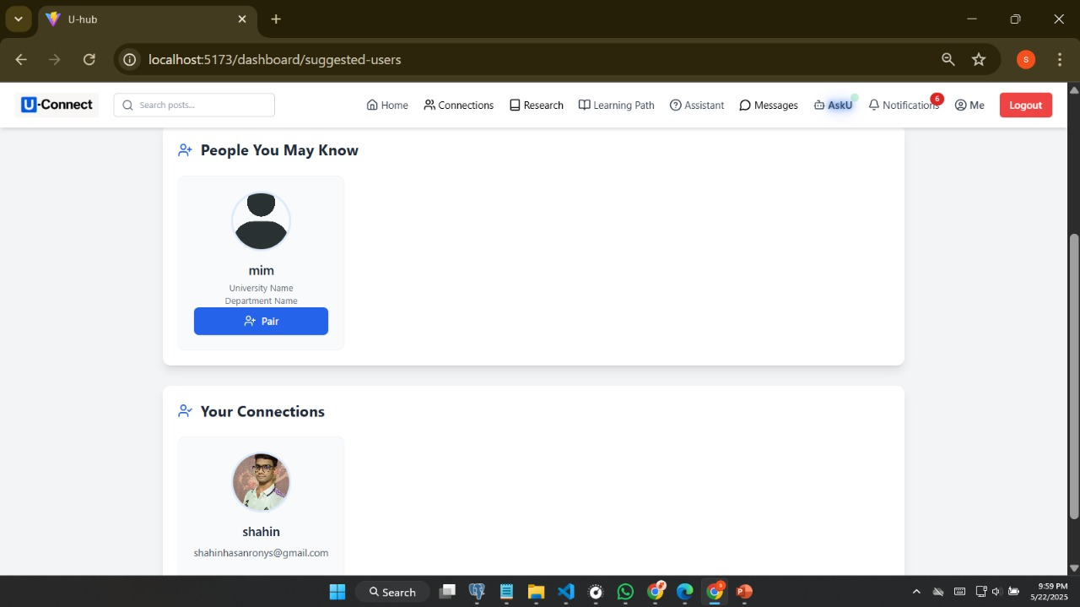
Contact Management
Create, look up, and maintain contacts
and statuses on profile cards
Conversations are easy to start.

Slide 8
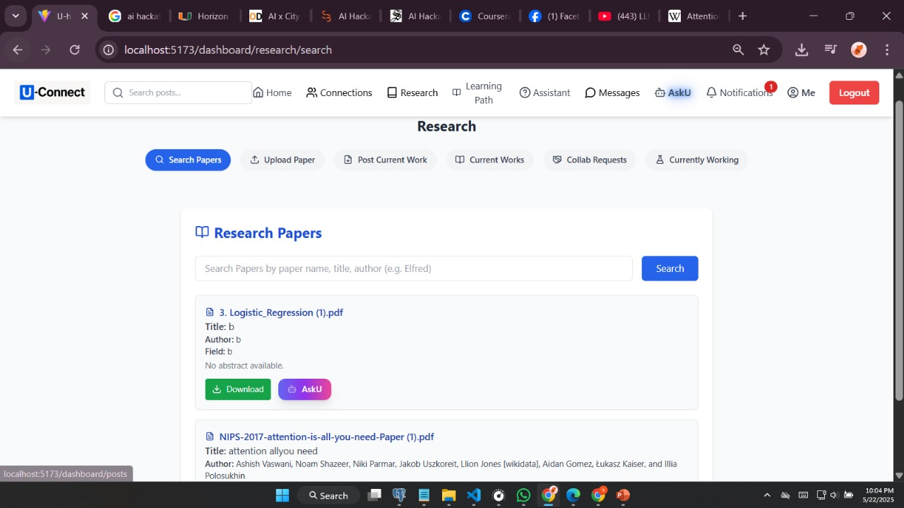
research management & collaboration
Share your research with others. Search your desired papres Quick and safe gearbox
Look for collaborators.
Trackyour own research.

Slide 9
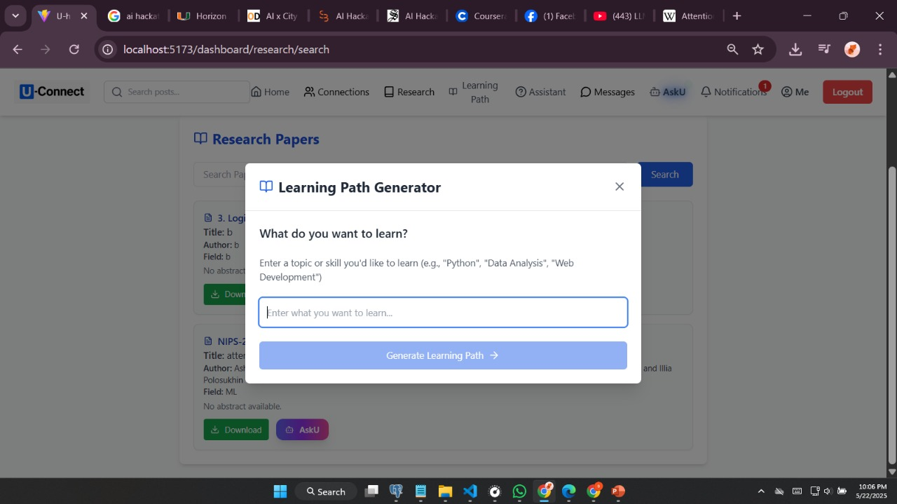
learning path generator
One can generate one’s customized learning path for his owndesired topic

Slide 10
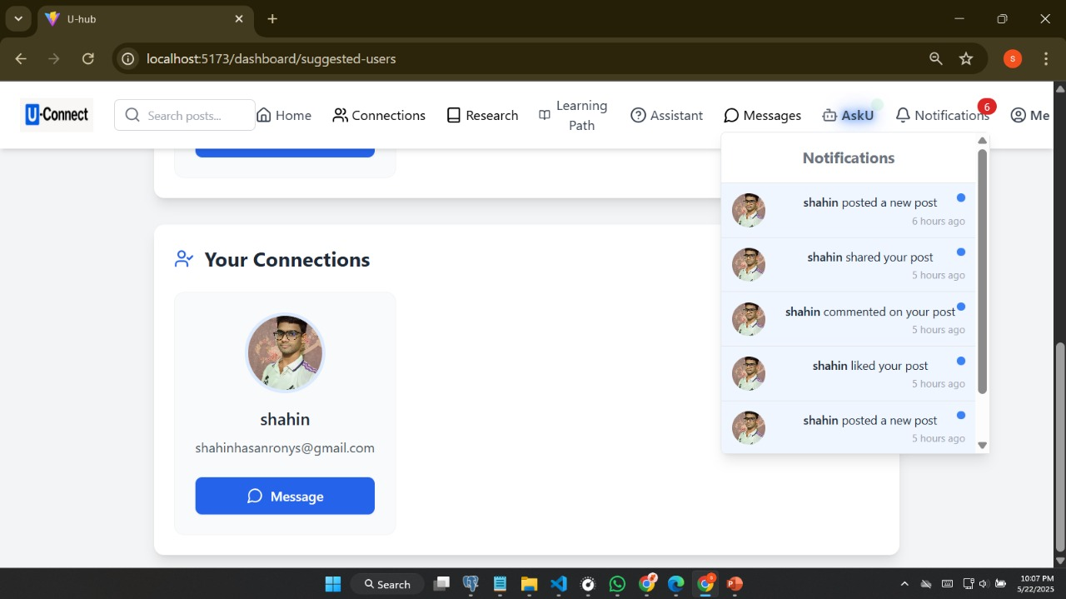
Notification System
Alerts on desktops and mobile devices
Control over the types of alerts in detail
keeps users informed and involved

Slide 11
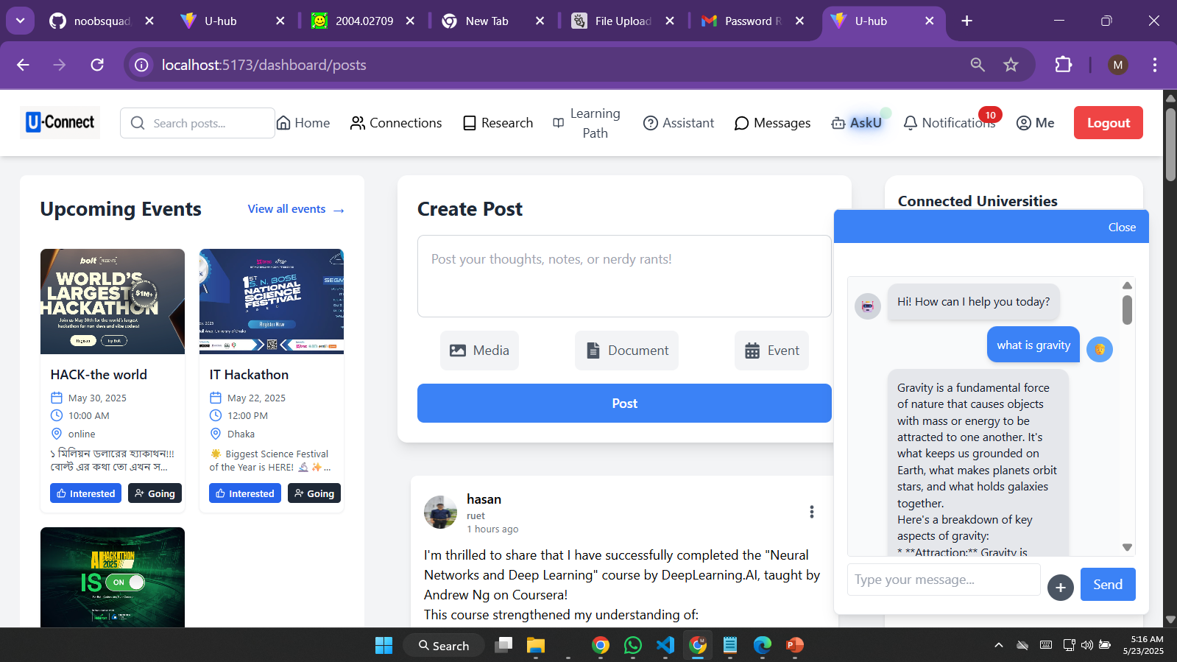
ai powered chatbot
Editing profiles and customising themes
Settings for language and notifications
Options for dark and light modes

Slide 12

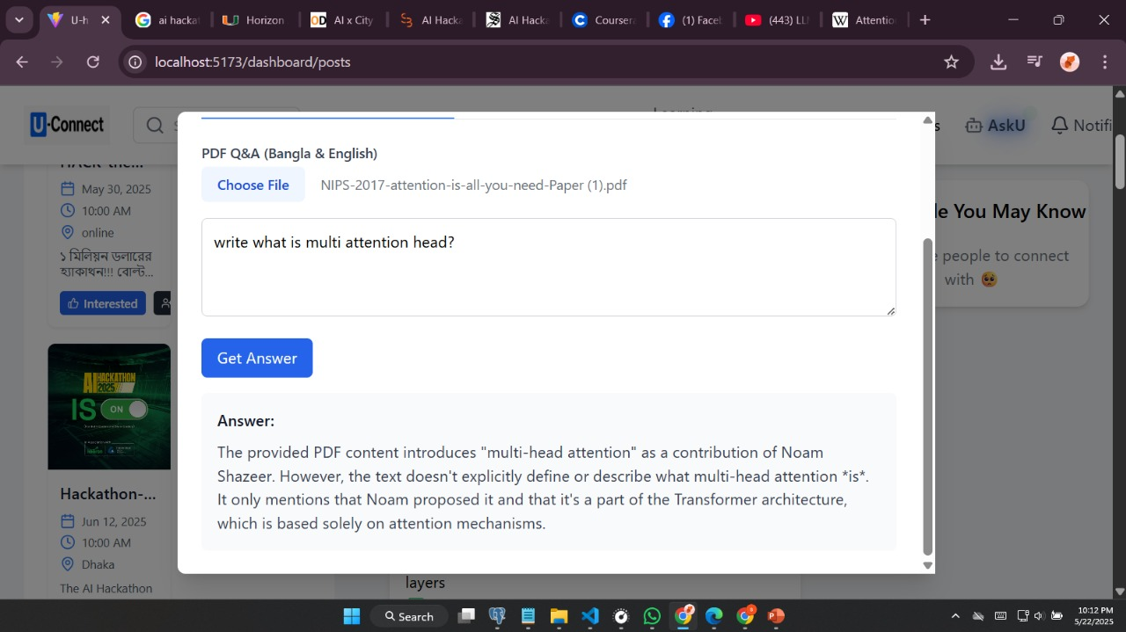
Q&A with pdf
One can upload his/her study materials as pdfand then through asking question he/she can extract desired knowledge from here throumthis llm powered Q&A section.

Slide 13
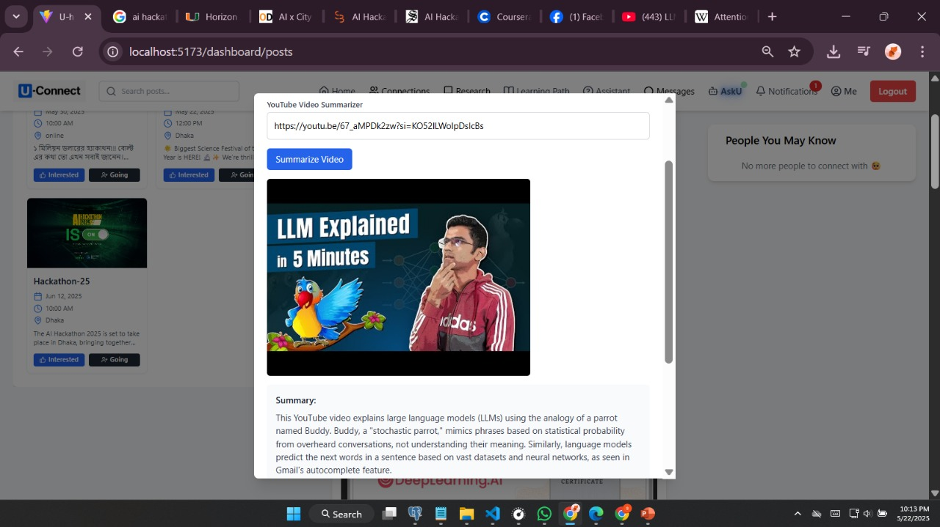
Video summarizer
You can either paste a video link or upload a video file (for example, from YouTube).
The viddio is transcribed by the system.
AI evaluates and highlights important points.
Output: a clear, understandable synopsis of the full video

Slide 14
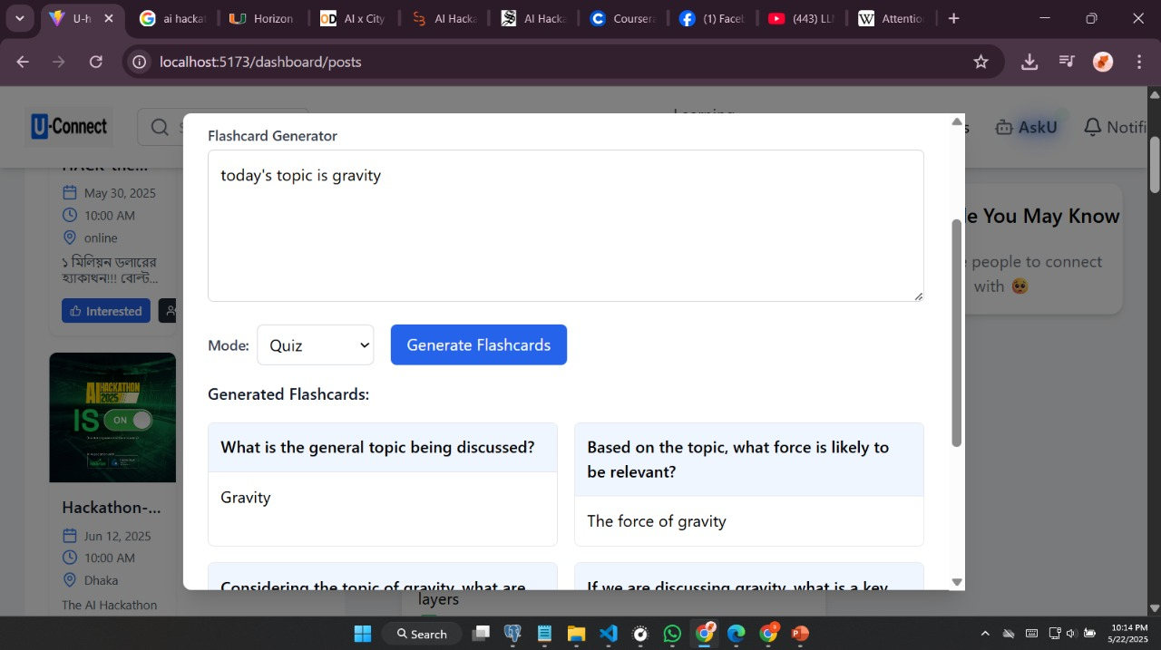
Flashcard & Quiz Maker
Generate interactive flashcards from notes or text.
Perfect for professionals, students, and brief review sessions
allows multiple-choice tests to be automatically generated.

Slide 15
Security & Accessibility
Communication that is encrypted
Communication that is encrypted
Access controls based on roles
All-device responsive design

Slide 16
DEVELOPMENT
01.Enhence AI featured(use transformer or fine tuned model)
02.Make mobile application.
03. Integrate academic section.
04.Expandlearningtools.
05.Make global community.
06.Make an tracing system.

Slide 17
THANK YOU

